Slide 1

IN VEHICLE COUPON RECOMMENDATION
Devi Vara Prasad Rongala

Slide 2
AGENDA
Introduction
Project Overview
Dataset & Variables
Why are we working on this?
EDA
Business Insights
Modeling
Ethical Considerations
Conclusion
Best Practices

Slide 3







INTRODUCTION
WHY COUPONS?
In today’s world understanding customer behavior is very important for businesses to optimize their performance and achieve their targets. Companies are looking to improve their business and even want to improve marketing. strategies when people are traveling. Coupons are powerful tools that can boost customer purchasing and increase customer loyalty. Machine learning can be used to know how coupons affect customers.

Slide 4





INTRODUCTION
PROBLEM STATEMENT:
PROBLEM: what type of coupons must be created in the market?
SOLUTION :Predict the type of coupons that will be accepted by the customers.
HOW? Use recommendation systems as they use some well-known algorithms to analyze customer data and their past purchase trends and generate useful recommendations about the type of coupons that can be generated to increase the sales.
PROBLEM: is it profitable for the companies to invest time and money to generate coupons?
SOLUTION: Find the probability of coupon acceptance.
HOW? Use machine learning models

Slide 5




PROJECT OVERVIEW
In-vehicle coupon recommendation is recommending coupons for driving users so that they can redeem them later until the expiry. Here the customers are mobile.
GOAL:
The goal is to examine the acceptance rate of coupons that are suggested to people in various driving situations by analyzing a dataset obtained from the Amazon Mechanical Turk survey.
Also, in this project, we can recommend to the business/salesperson what type of coupon (restaurant, bar, carryout, coffeeshop) can be given to the customers so that coupons won’t get wasted. The dataset provides a picture of contextual dynamics about coupon acceptance using demographic factors like weather, time, and destination, etc.,

Slide 6
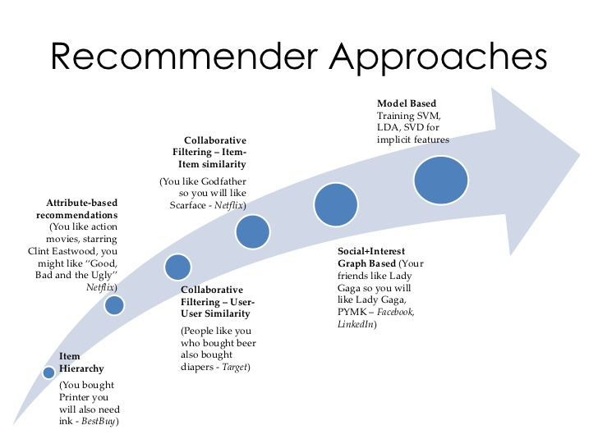
BEST PRACTICES

Slide 7
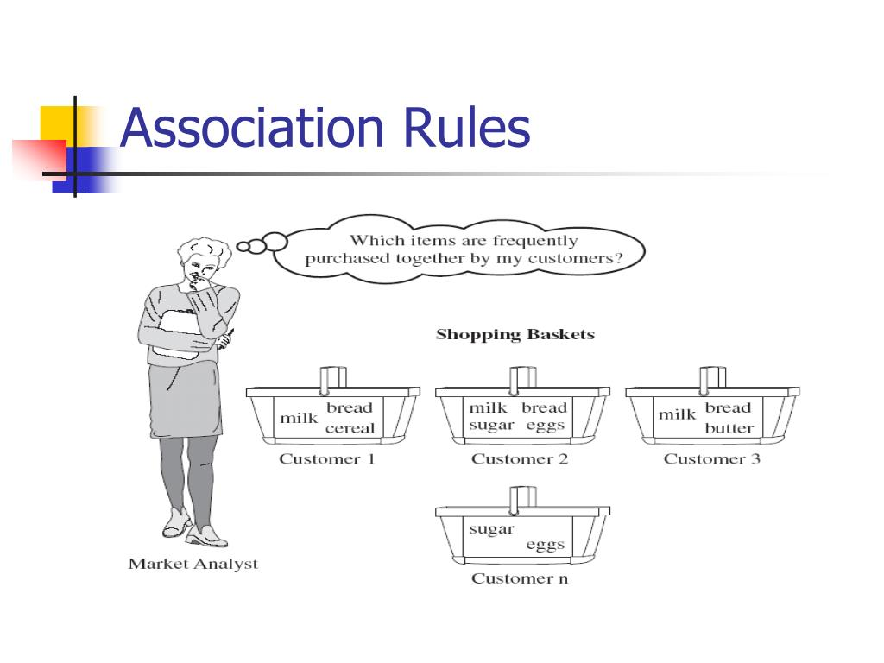
BEST Practices
Association rules and Correlation:
Observation is in the positive class if at least one of the rules is satisfied, otherwise it is in the negative class. Here is an example of a rule set model:
if a customer (goes to coffee houses ≥ once per month AND destination = no urgent place AND passenger 6= kids)OR (goes to coffee houses ≥ once per month AND the time until coupon expires = one day) then predict the customer will accept the coupon for a coffee house.

Slide 8
DATASET & VARIABLES
URL: https://archive.ics.uci.edu/dataset/603/in+vehicle+coupon+recommendation
The dataset on in-vehicle coupon recommendation was donated on September 14, 2020. It consists of 12,684 instances and 23 features. The information was gathered through an Amazon Mechanical Turk poll in which participants were asked if they would take a voucher that was suggested to them in various driving situations.

Slide 9








DATASET & VARIABLES
Destination :Destination of the driver
Passenger Who is travelling
Weather Condition of weather
Temperature Temperature in Fahrenheit
Time Time of day
Coupon Type of coupon
Expiration Expiration time of coupon
Gender Gender of the person
Age Age of the person
Marital status Marital status of driver
Has children Whether the driver has children
Education Education level of driver
Occupation Occupation of the driver
Income Income range of driver

Slide 10
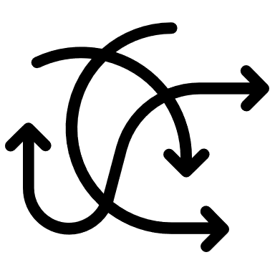



DATASET & VARIABLES
Car If it is car or another vehicle
Bar Frequency of visiting bars per month
CoffeeHouse Frequency of visiting coffeeshops per month
CarryAway Frequency of getting takeaway per month
RestaurantLessThan20 Frequency of visiting restaurants with expense <20$ per month
Restaurant20To50 Frequency of visiting restaurants with expense 20$-50$ per month
toCoupon_GEQ5min Is the driving distance for using the coupon is greater than 5 minutes
toCoupon_GEQ15min Is the driving distance for using the coupon is greater than 15 minutes
toCoupon_GEQ25min Is the driving distance for using the coupon is greater than 25 minutes
direction_same Is the restaurant/bar is in the same direction as the current direction of destination
direction_opp Is the restaurant/bar is in the opposite direction as the current direction of
destination
Y If the coupon is accepted (1) or not (0)

Slide 11
Why are we working on this?
Both businesses and customers get profits using the recommendation systems as the businesses
create useful coupon types that will boost their profits and customers will be satisfied by the services the businesses provide.
Consumer behavior or psychology can be studied in this process.
Also, we can find how far data analysis is helping different marketing strategies and data-driven decision-making.
Companies may discover more advanced marketing strategies by using the knowledge of consumer behavior.
Efficient schemes or discounts can be planned by the companies after understanding consumer preferences.

Slide 12
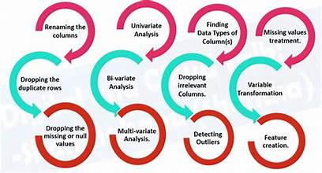






Exploratory data analysis

Slide 13
DATA PRE-PROCESSING
Dropped duplicate values and Mode imputation is done to handle missing values: Used fillna () method and done mode imputation. Car has the highest missing data ,so removed the column completely

Slide 14

are the classes balanced or imbalanced?
We could see that the classes are balanced as the accepted class has 7157 examples and rejected class have 5453 examples

Slide 15
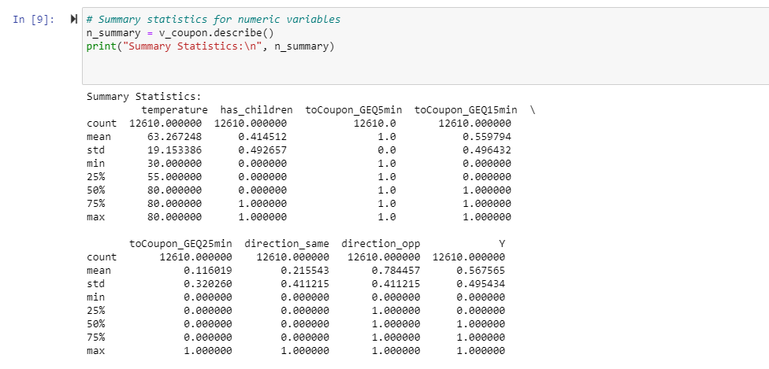
DESCRIPTIVE ANALYSIS
15

Slide 16
Finding correlation between Variables
toCoupon_GEQ5min does not have any significance with target variable Y. Hence, we can remove that. Direction_same and direction_opp have the same correlation with the target variable. Hence we can remove one of them.

Slide 17
Finding correlation between Variables
The coefficient of 0.13 signifies that there is a weak positive correlation between the expiration ime and coupon acceptance. Increase in expiration time does affect the coupon acceptance.
coefficient of -0.03 signifies a weak correlation. As age increases, coupon acceptance decreases

Slide 18
UNI VARIATE ANALYSIS
Almost every coupon that is between 20-50 worth is accepted. Customers are accepting coupons for high-quality restaurants.
There are more rejections among coupons for bars and coffeehouses.
People also redeem and carry out coupons more often.
Drivers with 37500-62500, and 1000000 tend to redeem more coupons. Redemption is more
among 12500-37500 too.
Customers with high school and bachelor’s degrees accept coupons more. Whereas graduates and no degree students rarely accept the coupons

Slide 19
MULTI VARIATE ANALYSIS

Slide 20
FEATURE TRANSFORMATION
Created a single distance column using feature engineering. Coupons that are less than 15 min driving distance as 0, between 15-25 minutes as 1, and greater than 25 minutes as 2. Coupons that are less than 15 minutes driving distance are accepted more, than 15-25 minutes. Customers tend to reject coupons that are more than 25 minutes driving distance.

Slide 21
FEATURE ENCODING
Mapped different categories accordingly to make the analysis easy

Slide 22

BUSINESS INSIGHT 1:FREQUENCY ANALYSIS
COUPON VS AGE
COUPON VS EXPIRATION
How much percentage of coupons were rejected with expiration times 2h and 1d?
Expiration time 2h: 62.4% ACCEPTED 37.5% REJECTED
Expiration time 1d: 49.5 % ACCEPTED 50.4% REJECTED
Which age group has the highest acceptance rate of coupons?
21 and Below 21 is the age group with nearly 60-63% of acceptance.
There is 50-50 chances of coupon acceptance for drivers aged 46 years.

Slide 23
BUSINESS INSIGHT 2:histogram that illustrates how coupons are used by DIFFERENT age groups AND GENDERS
Male drivers between ages 21-29 and below 21 tend to reject more coupons. Whereas below 21 female drivers mostly don’t reject coupons. Female drivers aged between 50 plus reject morecoupons. Also, the highest acceptance Is by the male people for almost every age group.

Slide 24

BUSINESS INSIGHT 3:COUPON ACCEPTANCE VS TIME AND DESTIONATION
The highest number of coupons were accepted by drivers commuting to work at 7 AM. The next number of coupons were accepted at 10 PM and 6 PM and the destination was home and no urgent place.

Slide 25


ACCEPTANCE OF BAR COUPONS
Highest percentage of bar coupons were accepted by those aged 21 years. Higher income drivers accept 47.6% of the bar coupons. People with low income also accept 41-46% of coupons.

Slide 26
ACCEPTANCE OF COFFEE HOUSE COUPONS
69.7% of the coffeehouse coupons were accepted by drivers aged below 21 years.
Acceptance rate is good among all income groups.

Slide 27

ACCEPTANCE OF Restaurant COUPONS
Drivers with an income range of 87500-99999 accept most restaurant coupons.
Also, the age group of 36 and 46 accepts more coupons.

Slide 28



MODELING
DATA PREPROCESSING/FEATURE SELECTION
MODEL TRAINING
DATA SPLITTING(80:20)
MODEL EVALUATION
MODEL TUNING HYPERPARAMETERS

Slide 29
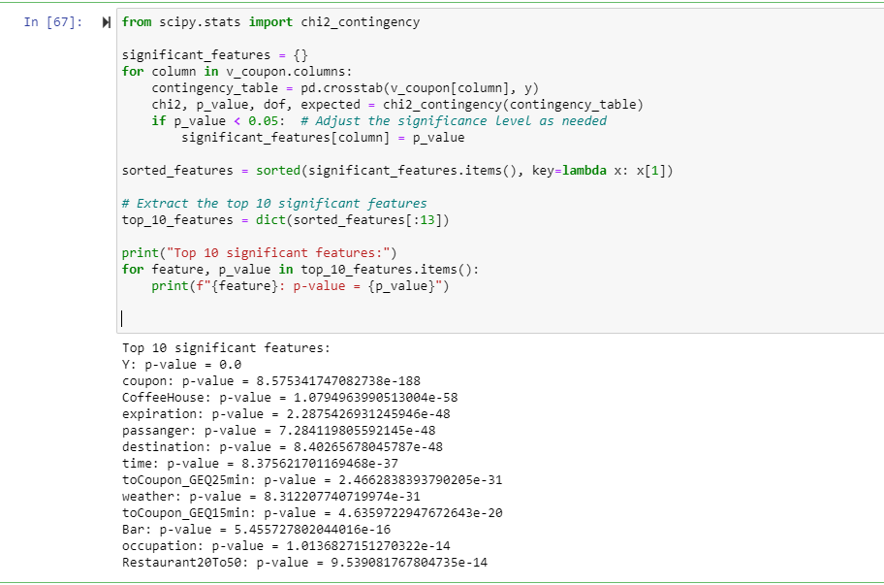
STATISTICAL ANALYSIS TO CHOOSE FEATURES FOR MODELS
Select top 10 features:
Choose features that has p-value<0.05
Selecting top features is crucial for Model performance

Slide 30
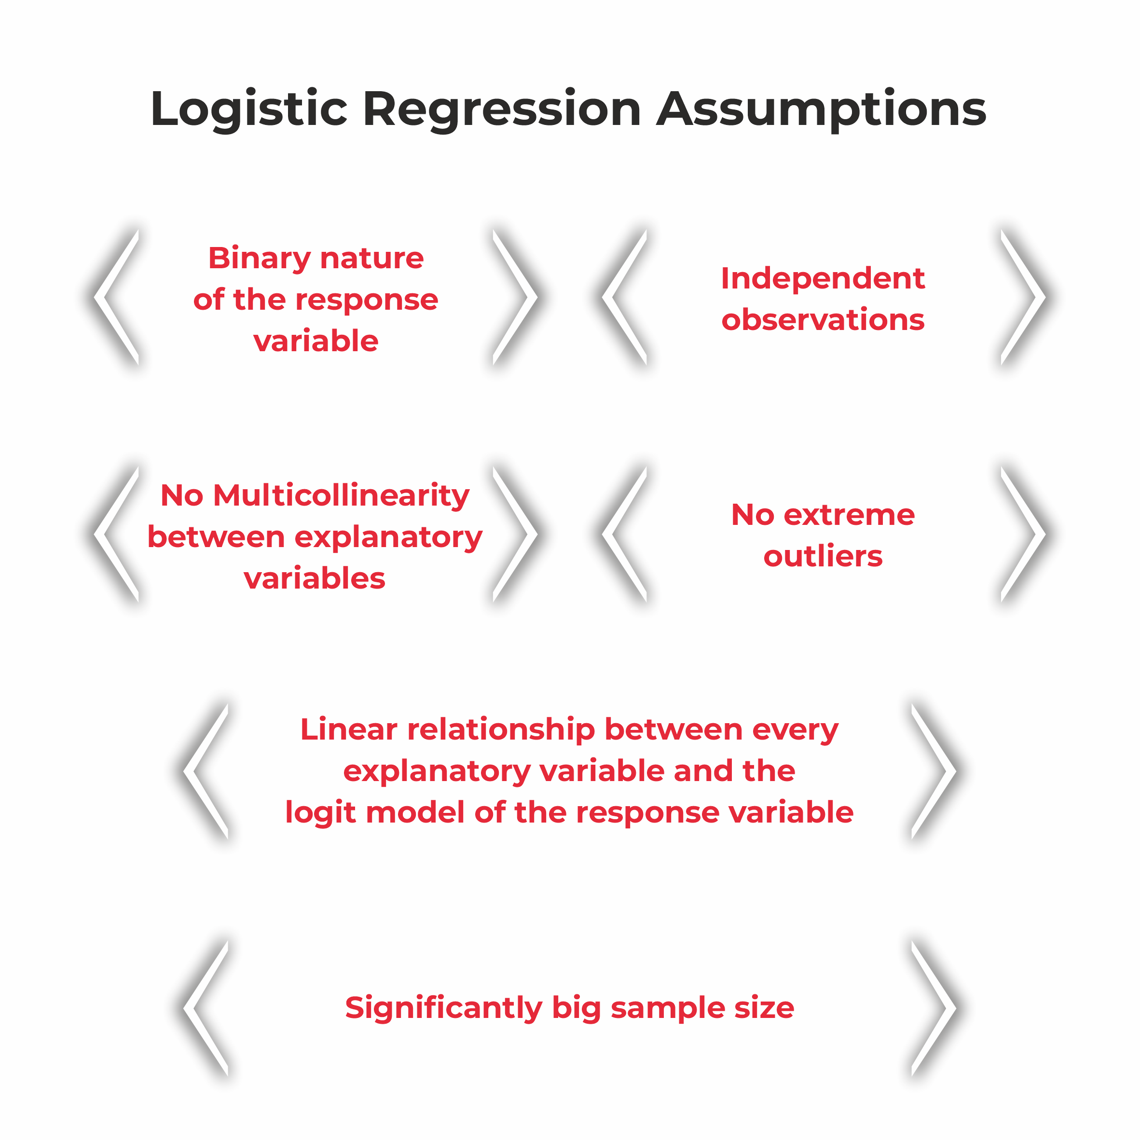
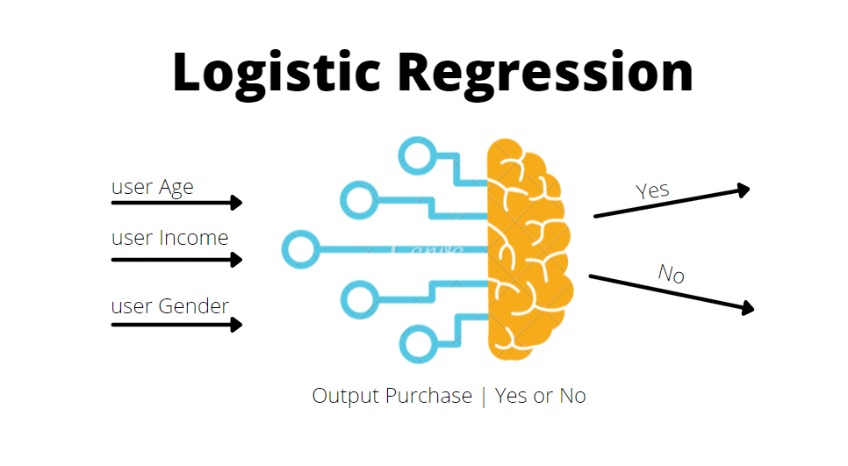

Slide 31
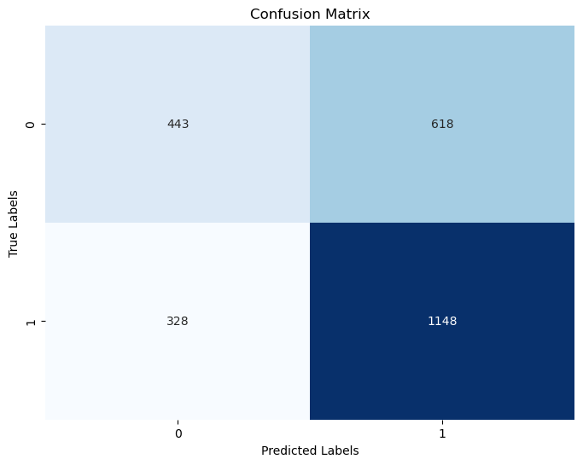
LOGISTIC REGRESSION
Used statistical significant variables and trained the logistic regression model.
CONFUSION MATRIX RESULTS:
co
True Positives(TP)
1148 instances where model predicted correct coupon usage(Y=1)
True Negatives(TN)
444 instances where model predicted no coupon usage(Y=0)
False Positives(FP)
618 instances where model incorrectly predicted
Coupon usage where there was none
False Negatives(FN)
328 Instances where model incorrectly predicted no coupon usage where there was one.

Slide 32
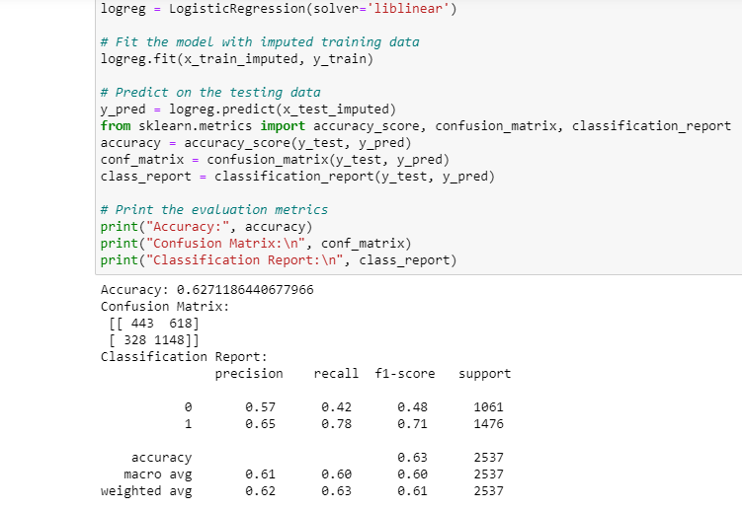
LOGISTIC REGRESSION
PERFORMANCE METRICS:
Accuracy is 62.71 which indicates that the model correctly predicts the coupon usage for 62.71 percent of instances in the dataset
Precision of 0.65 for class 1 means that out of all instances predicted as using a coupon,65% were actually using a coupon
Recall of 0.78 for class 1 shows that the model correctly identified 78% of all instances where a coupon was used.

Slide 33
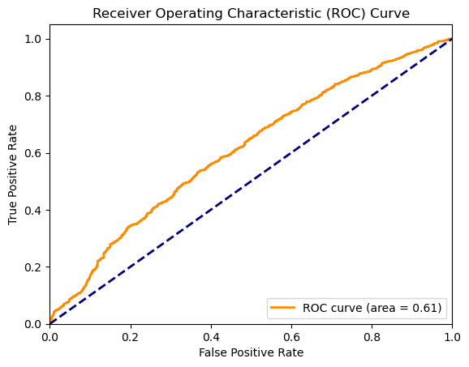
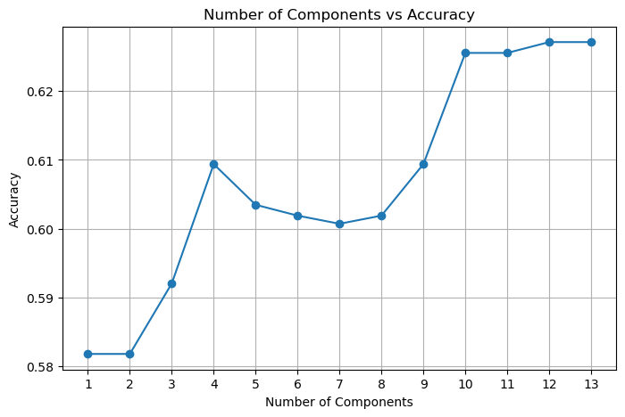
LOGISTIC REGRESSION
Principal Component Analysis helps to capture the most important patterns in data while reducing the number of features.
Highest accuracy is achieved with
Nearly 10-13 components.

Slide 34
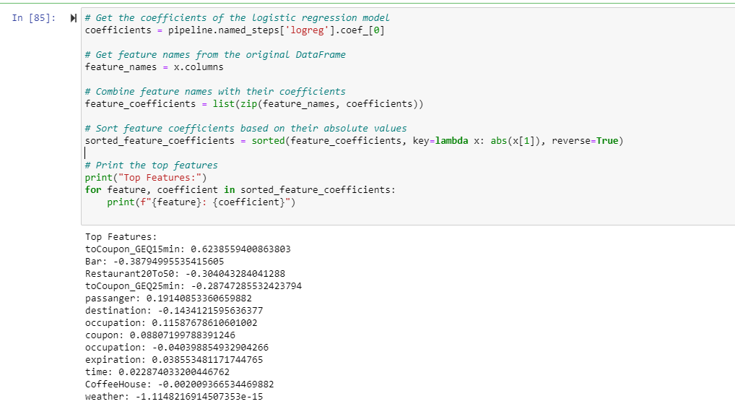
LOGISTIC REGRESSION:COEFFICIENTS
Positively related features:
toCoupon_GEQ15min,Coupon,Passanger.As these values increase possibility of coupon acceptance increases.
Eg: People who travel 15 minutes and more are most likely to accept coupons.
Negatively related features:
Bar,Restaurant20To50, toCoupon_GEQ25min,weather.
Eg:Those who prefer bar are less likely to accept the coupons.

Slide 35
LOGISTIC REGRESSION:PREDICT PROBABILITY
User data is passed to the function logreg.predict_proba which can be used to predict the probability of coupon acceptance

Slide 36
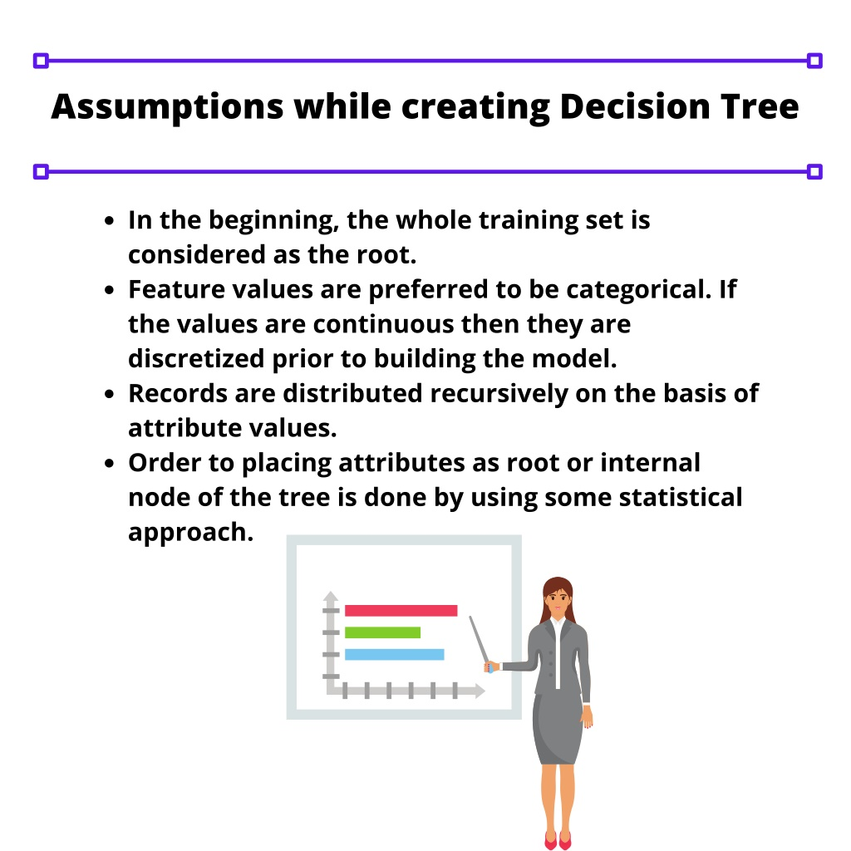
DECISION TREE

Slide 37
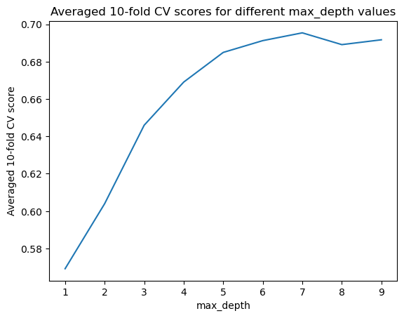
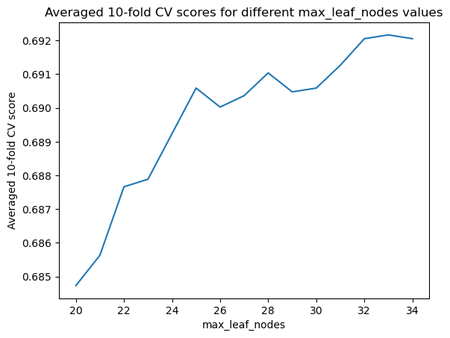
DECISION TREE:TUNING HYPERPARAMETERS

Slide 38
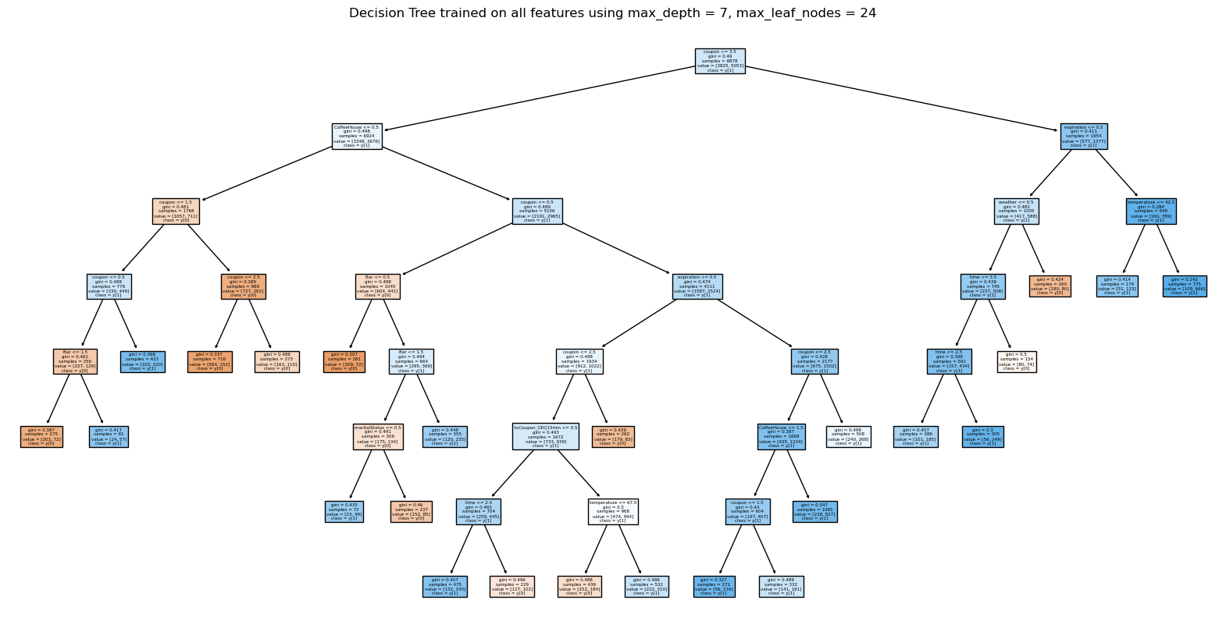

Slide 39
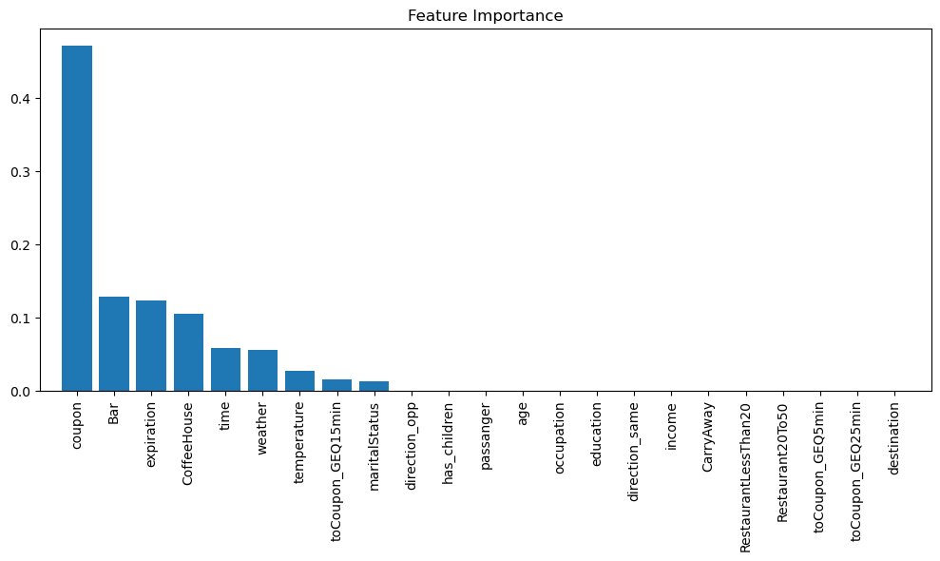
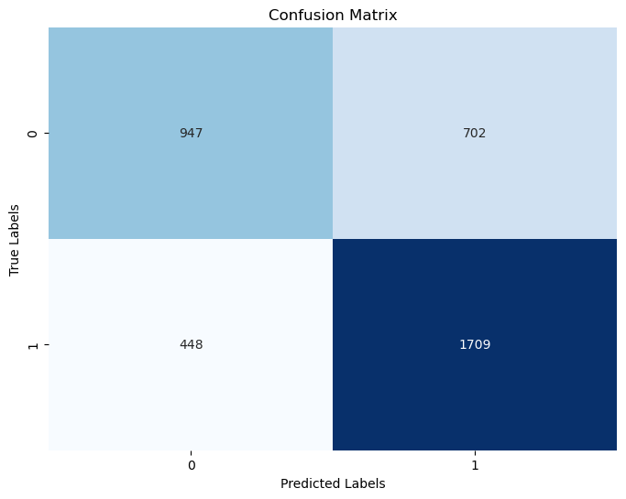
TOP FEATURES CONTRIBUTING TO DECISION TREE ACCURACY
ACCURACY :70%

Slide 40
Predicting coupon acceptance using decision tree and user input

Slide 41
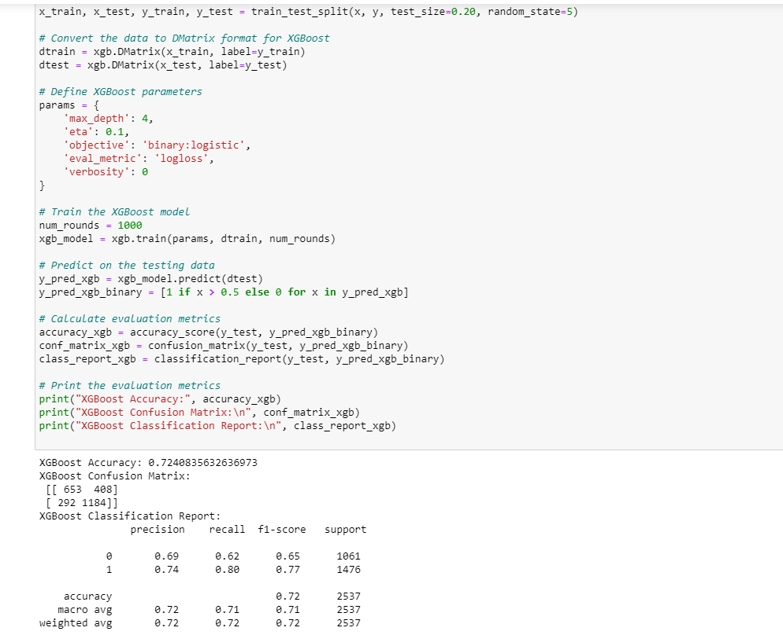
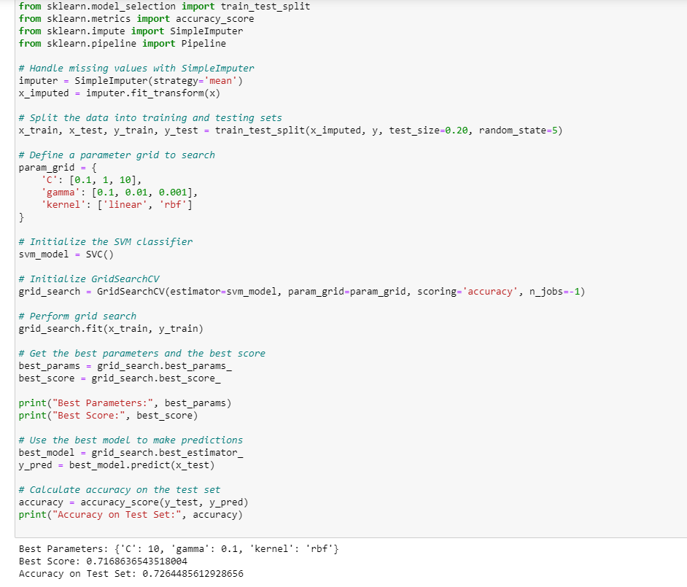
Other models:
XG BOOST :72.4%
Best Parameters: {'max_depth': 4, 'objective': 'binary:logistic', 'eval_metric': 'logloss','verbosity': 0}
SVM :72.6%
Best Parameters: {'C': 10, 'gamma': 0.1, 'kernel': 'rbf'}

Slide 42
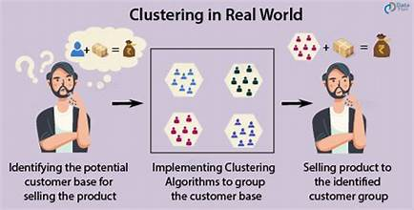
CLUSTERING

Slide 43
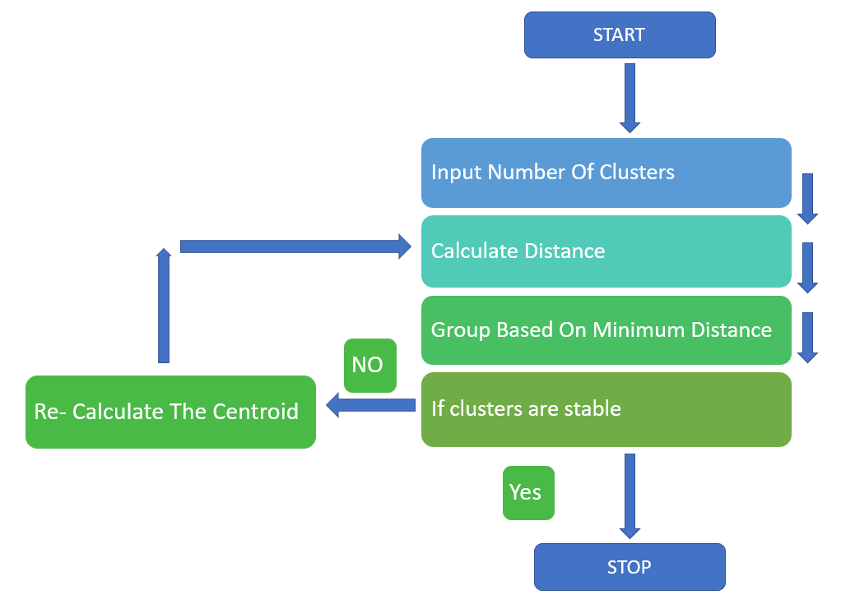
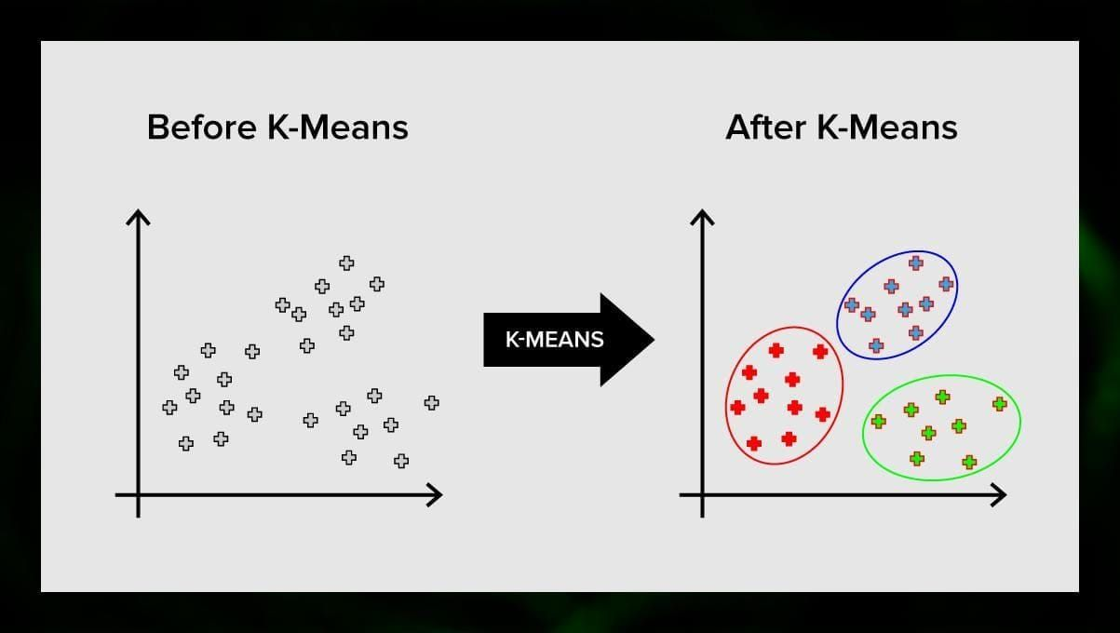
K-MEANS CLUSTERING

Slide 44
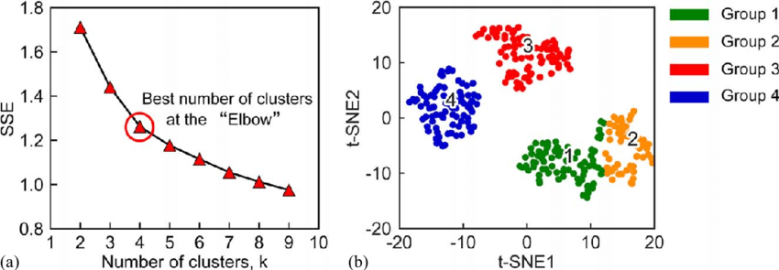
ELBOW METHOD:

Slide 45
CLUSTERING RESULTS
Passenger 0-alone 1.0-friends 2.0- kids 3.0- partner
Coupon: 0- bar,1-carryout, 2-coffeehouse, 3-restaurant <20,4- restaurant20To50.
Coupons for restaurants(<20) are preferred when traveling with kids and partner

Slide 46
CLUSTERING RESULTS
Weather-0: Sunny,1: Rainy ,2: Snowy
Most coupons are accepted for rainy and snowy reasons and mostly they are for carryout,coffeehouse, and restaurant (<20) coupons
Time: {'7AM': 0, '10AM': 1, '2PM': 2, '6PM': 3, '10PM': 4}
Coupons for restaurants are redeemed mostly during evenings and nights

Slide 47
CONCLUSION
Our models developed can be used to provide recommendations to the customers and also help businesses to make more profits.
REAL WORLD APPLICATION: Businesses can Integrate the models into mobile as an application or reservation systems to provide personalized recommendations to travellers regarding the coupons based on their profile and circumstances.
DYNAMIC PRICING AND INVENTORY MANAGEMENT: Generate only the required amount of coupons by predicting the demand using the models and plan pricing schemes that bring profits .
MARKETING CAMPAIGNS: Plan targeted advertising during specific time and weather conditions where the coupons are most redeemed .

Slide 48
CONCLUSION
REWARDS: Filter users who mostly use coupons and provide them with more rewards and discounts.
MULTI CHANNEL INTEGRATION: Also integrate with social media platforms, Maps to provide a best experience with ease.

Slide 49
CONCLUSION
HOW OUR PROJECT IS DIFFERENT FROM OTHER EXISTING RECOMMENDATION SYSTEMS?
We can accurately predict coupon redemption for an individual. Unlike generic models that concentrate on past history only, we can also provide personalized services to each customer based on his/her driving conditions and economic status. Our model is scalable and flexible that can work very well with huge datasets and growing market conditions.

Slide 50
